Slide 1

Welcome to Reception
2026-2027

Slide 2

Welcome
We would like to welcome you and your family to Abbey C of E Infant and Nursery School.
We will work together to make your child feel safe and secure which will enhance their learning, progress and development at school.
Our Vision:
Shine Brightly
(Jesus said) “You are the light of the world. A town built on a hill cannot be hidden. Neither do people light a lamp and put in under a bowl. Instead they put it on a stand, and it gives light to everyone in the house. In the same way, let your light shine before others, that they may see your good deeds and glorify your father in Heaven.
” (Matthew 5: 14-16) (taken from the Sermon on the Mount)

Slide 3
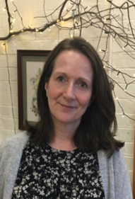
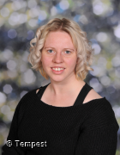
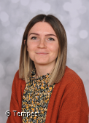
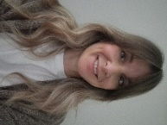


Reception Team 2026-2027
Maple
Willow
Early Years Lead/ Class teacher
Mrs Lawlor
Teaching assistant Mrs Smedley
Class teacher
Miss Murphy
Teaching assistant Mrs Edmondson

Slide 4
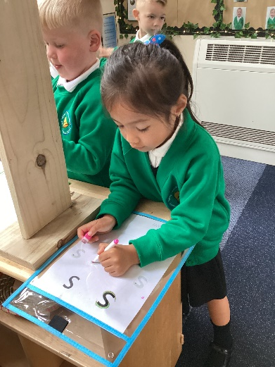
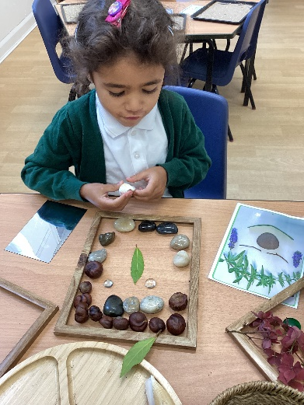
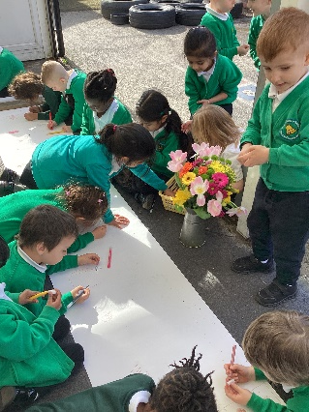
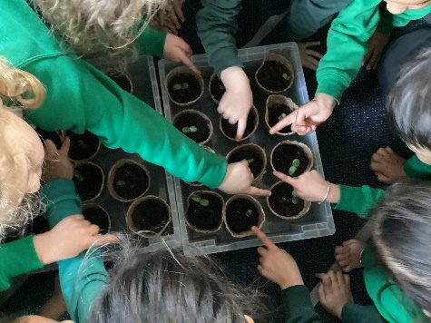
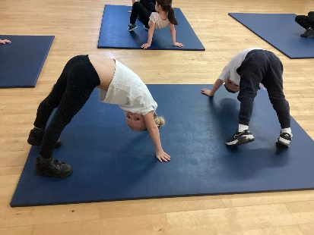
School day
8.30- come in to school, register, breakfast, fine motor activity or worship
9.00- 9.45- Little Wandle phonics/ reading groups
9.45- 10.30- Planned play/ group work
10.30- 10.45- Snack time
10.45- 11.00- Playtime
11.00- 11.35- Maths
11.35- 11.45- Story time/ getting ready for lunch
11.45-12.45- lunchtime
12.45-1.15- Topic work
1.15- 2.30- Planned play/ group work
2.30- Story time/ Rhyme time
3.00 pm- Home time.
This timetable evolves across the year, carefully balancing play-based learning with increasing opportunities for more formal learning experiences.
School starts at 8:30am. Good attendance and punctuality is very important for both academic and social success. School ends at 3pm.

Slide 5
What to bring each day
Water bottle
Book bag (no rucksacks please)
Coat – children will go outside for playtime even in light rain, so please make sure they have one every day
Reading book and diary (once these have been issued)
Spare clothes – a full set in case of accidents or spills (to be kept in your child’s bag)

Slide 6
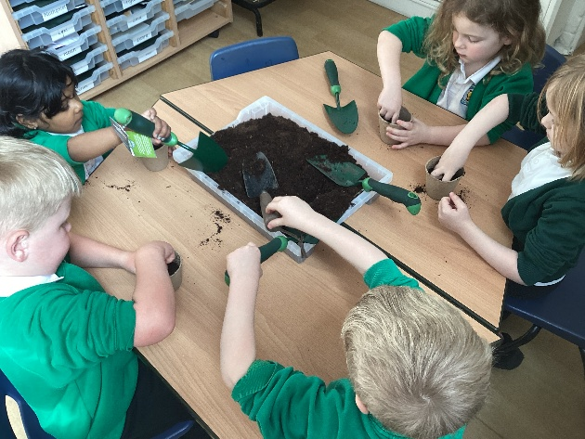
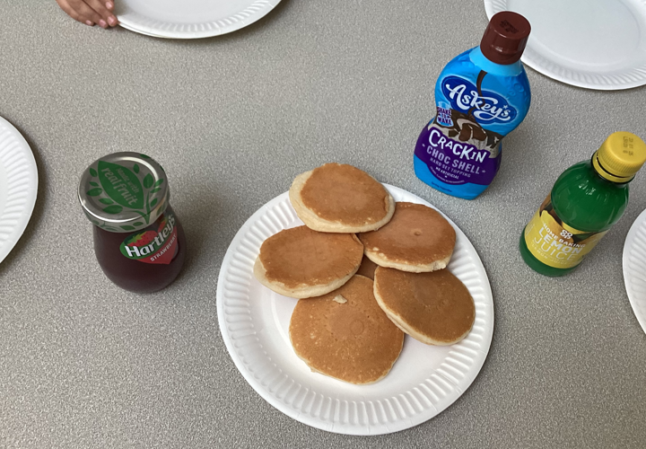
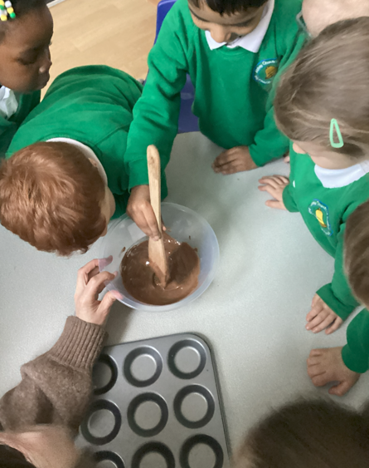
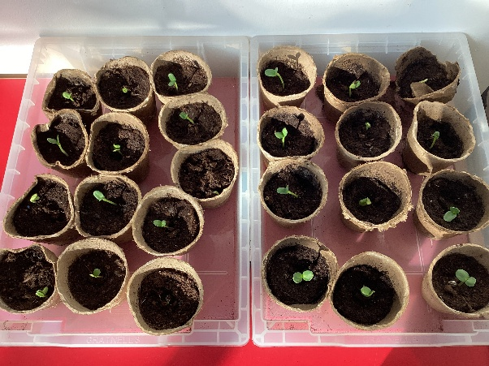
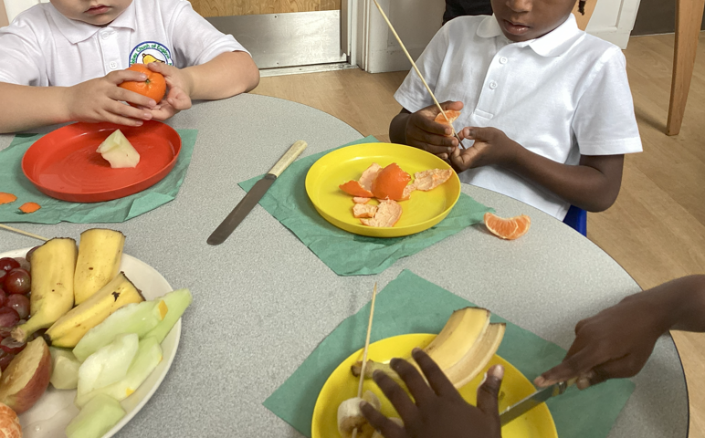
School Fund
Voluntary contribution of £1 a week
A voluntary contribution of £1 per week is welcomed to help support a range of enriching experiences for the children, including cooking, planting, and other hands-on activities. These opportunities enhance and enrich their learning by developing practical skills, encouraging curiosity, and bringing classroom learning to life in a fun and meaningful way.

Slide 7
What Does Learning Look Like in Reception?

Slide 8

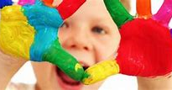
Curriculum
Key principles of the Early Years Foundation Stage (EYFS).

Slide 9
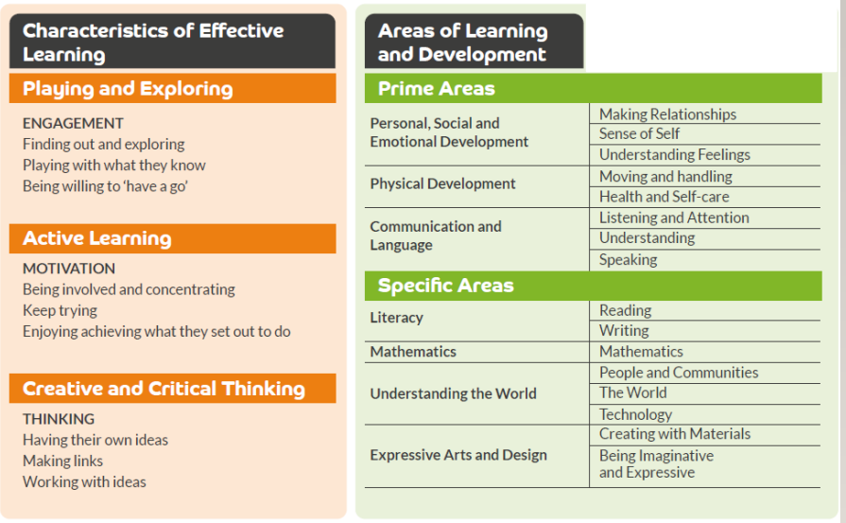
The Early Learning Goal
Children in Reception are expected to meet the Early Learning Goals, as set out by the Early Years Foundation Stage Framework in order to achieve a Good Level of Development.
There are 'specific' and 'prime' areas of the goals which children work towards.
There are also 'Characteristic of Effective Learning' that children are assessed against in to make sure they are fully prepared for their future academic progress in Year 1 and onwards.
The next slide details the ELGs in more detail:

Slide 10
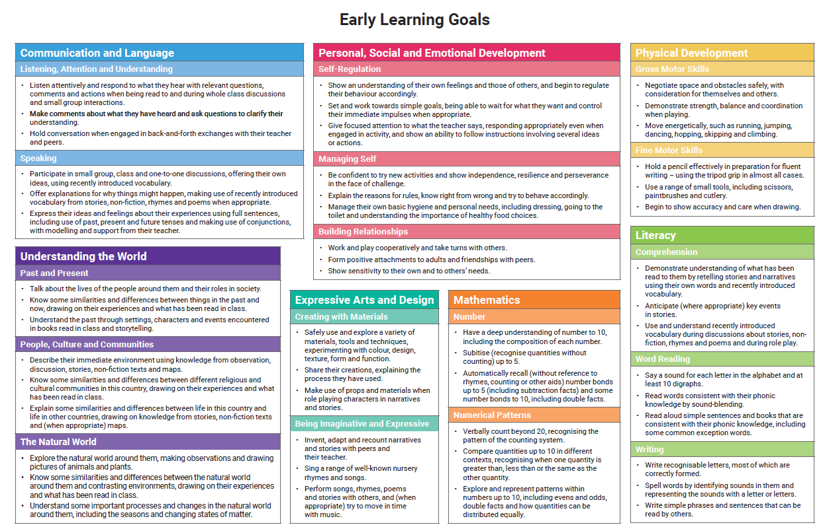

Slide 11
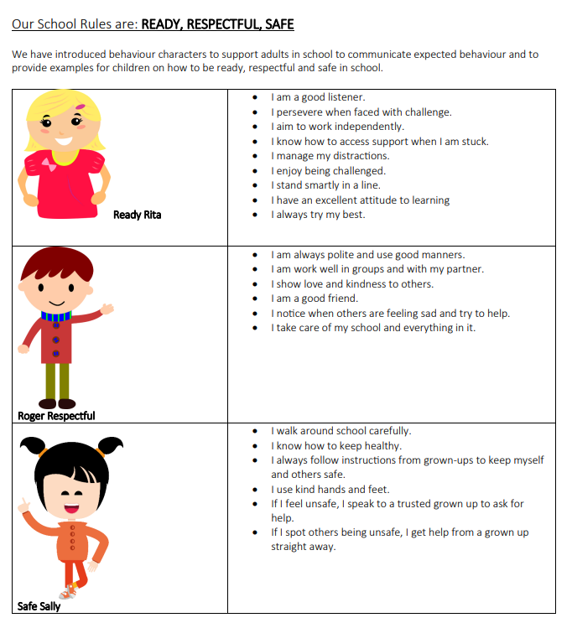

Slide 12




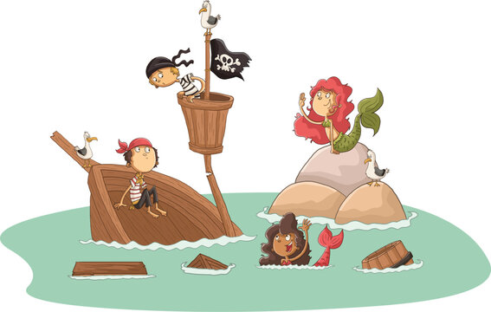

Our Topic Curriculum
Autumn 1- It’s great to be me!
Autumn 2- Celebrations of light
Spring 1- Once upon a time
Spring 2- Signs of Spring
Summer 1- All around the world
Summer2- Pirates and mermaids

Slide 13
Reception Baseline Assessment (RBA)
The Reception Baseline Assessment (RBA) is a short, informal check carried out in the first few weeks of Reception.
Your child’s teacher works one-to-one with your child, using simple, play-like activities to explore early skills such as language, number, and problem-solving. It usually takes about 10–20 minutes per session over a few short sessions.
It is not a test your child can pass or fail, and results are not shared with parents. Instead, the information is used by the Department for Education to measure the school’s overall progress by comparing this starting point with outcomes at the end of primary school.

Slide 14
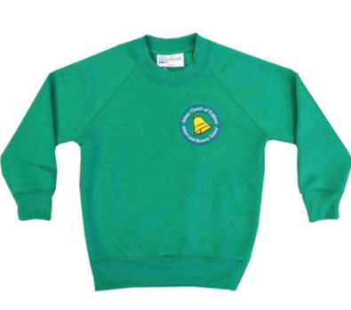
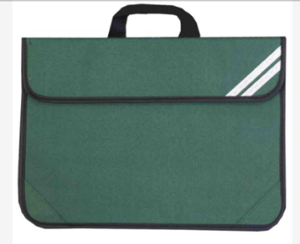
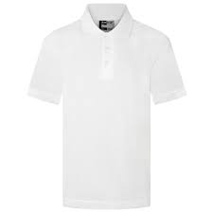
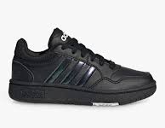
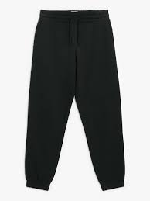
Uniform
Our children wear an ‘active 'uniform which ensures your child is comfortable and ready for every aspect of school life.
Green jumper or cardigan (logo optional),
White t shirt
Black joggers/ leggings/ shorts/ skorts.
Plain black Trainers (Velcro).
Wellies
Waterproof coat (trousers optional)
*** Please ensure everything is labelled***
We recommend all children have a book bag. They are an ideal size for keeping books tidy and fitting into drawers.
Watches or jewellery are not to be worn in school. This is for both safety and security.

Slide 15

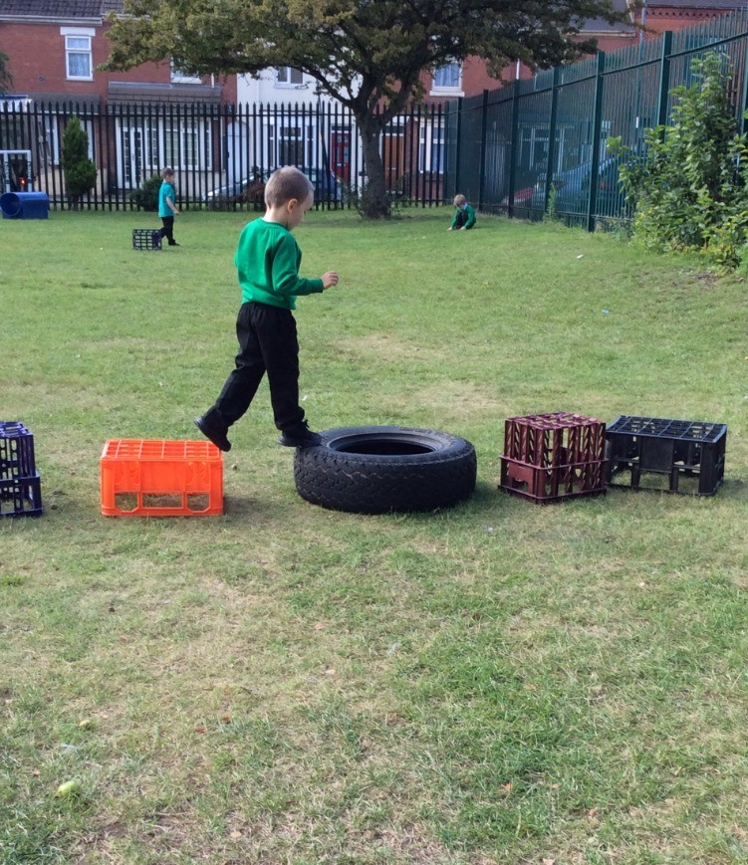
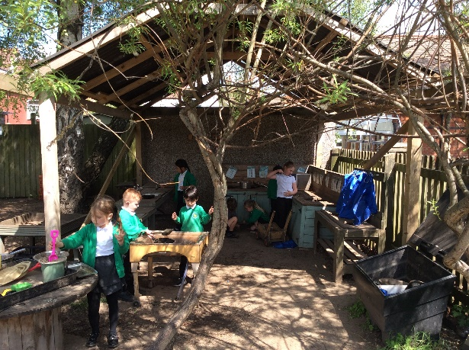
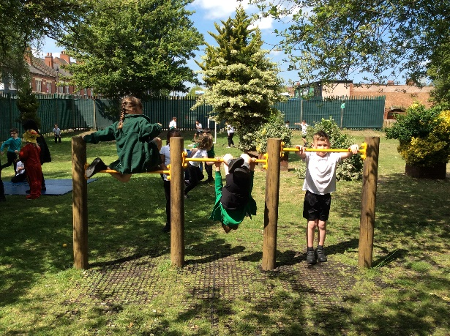
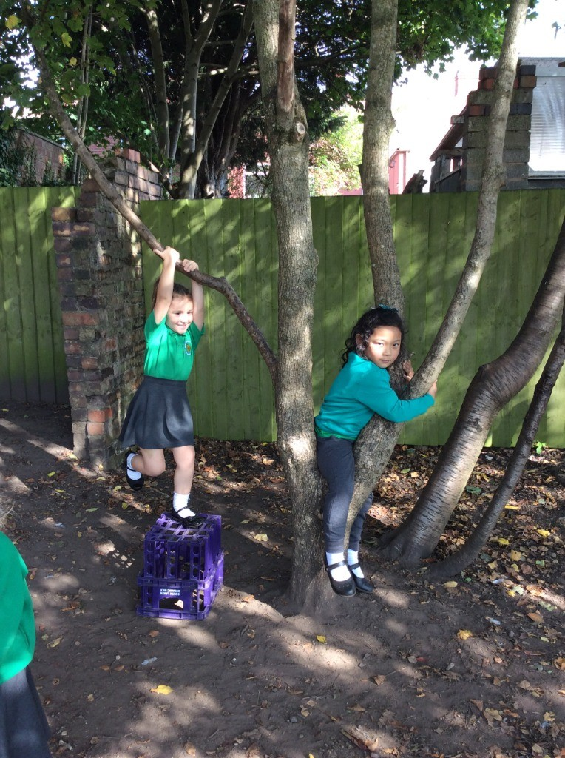
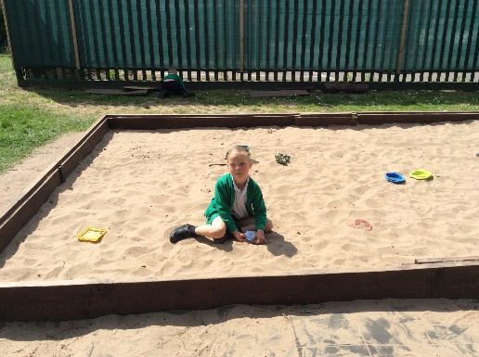
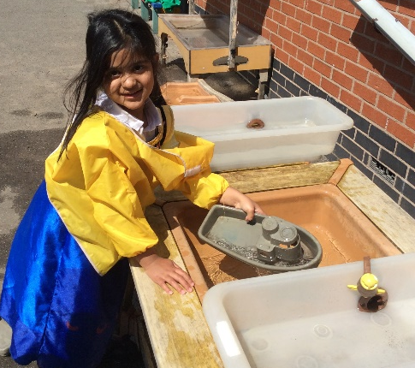
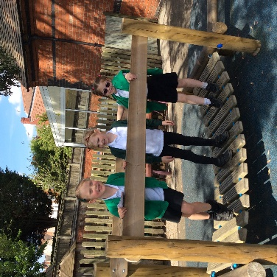
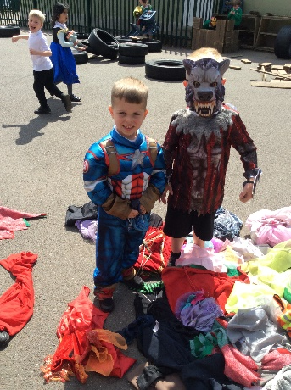
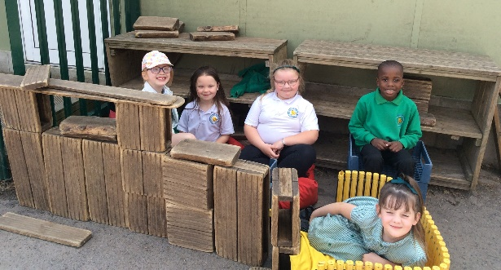
OPAL (Outdoor Play and Learning) is our approach to enriching playtimes, giving children more opportunities to explore, create, problem-solve and develop friendships through play. Research shows that high-quality play supports children's physical health, wellbeing, confidence and learning across the curriculum.

Slide 16


We will be using the Juniper app to improve communication between home and school. The app will allow school to share updates, reminders, and important information directly with parents, helping you stay connected and involved in your child's learning.

Slide 17


Phonics
We follow the Little Wandle phonics programme.
It is a way of teaching children how to recognise the sound that each letter makes.
It is an effective way of teaching young children how to read and write.
We have a daily sessions of phonics and your child will learn a new sound each day.
Single sounds are taught first, not letter names. Pronunciation is key!

Slide 18
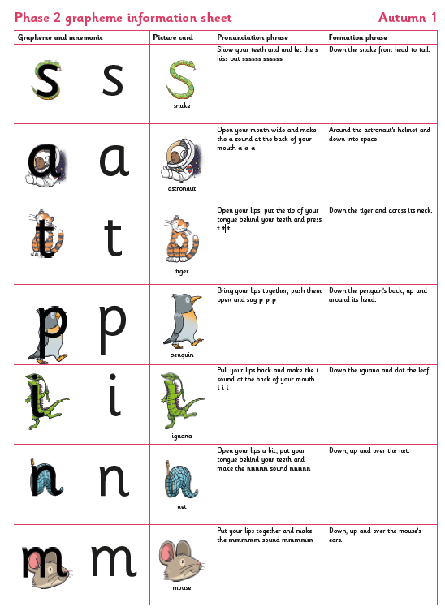
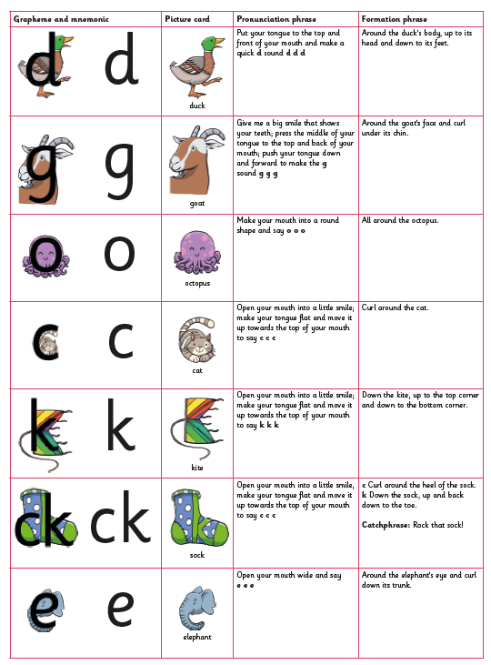

Slide 19
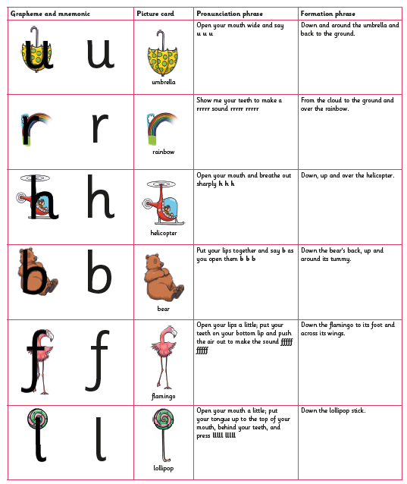

Slide 20
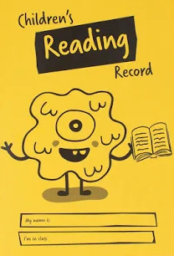
Reading at home
Reading together every day is one of the best ways to support your child’s learning. Children will begin bringing home Little Wandle reading books once they are ready.
Please read with your child little and often — even 5–10 minutes a day makes a big difference.
Sharing stories, talking about pictures and enjoying books together helps develop vocabulary, confidence and a love of reading
This reading diary is a space for you to record any reading your child does at home. This could include your child reading aloud, sharing a story with you, or listening while you read to them. Please write a short comment each time you read together, noting what your child enjoyed, how they engaged with the story, or any progress you noticed. Even a few sentences are helpful. Please also include the date and the title of the book or story if possible.

Slide 21
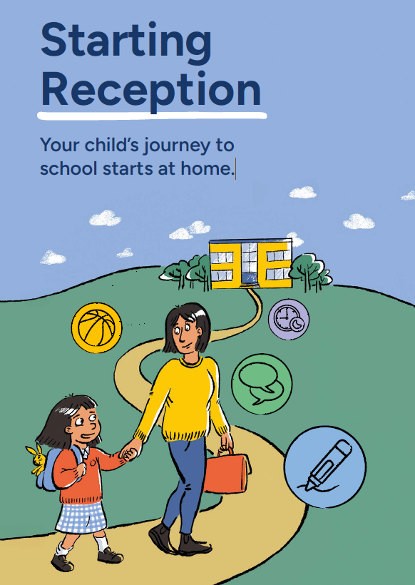
School Readiness
We understand that all children develop at their own pace, and that we’re all learning from birth. When it’s time to start school, some children will need more help than others.
There are key skills that schools expect children to be learning before their first day. Practising these will make your child’s journey to Reception as positive as possible.
If your child is already at nursery, in pre-school, or with a childminder, those professionals will work with you and your child to help get them ready.
There’s lots you can do at home to build your child’s confidence and independence, helping them feel emotionally and practically prepared to start school.
How can I help my child get ready?
Your child will have lots of new activities and routines to get used to when they start school. There are some things they’ll need to do more independently than they might have before.
Research shows that a child’s relationship with their parents is the most important factor in their development, and there’s a lot you can do at home.
When your child is at home with you or another caregiver, you can practise as a family with fun activities (we’ve included links at the end of this resource).
Some of these skills take time to master, so it’s good to introduce them gradually in your daily routine.

Slide 22
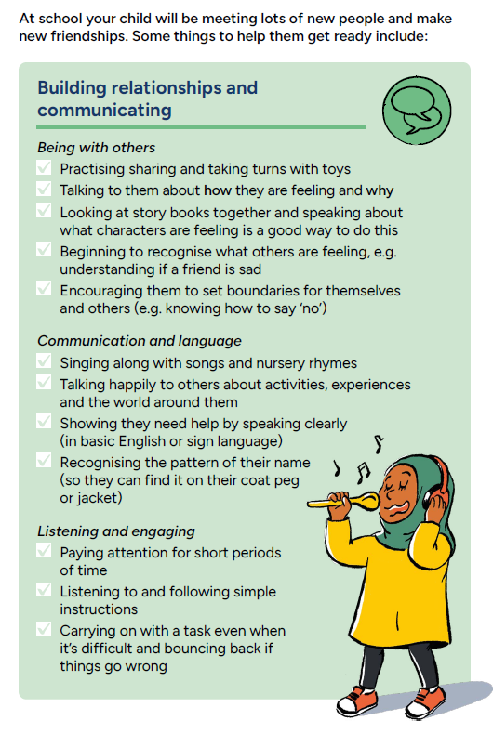
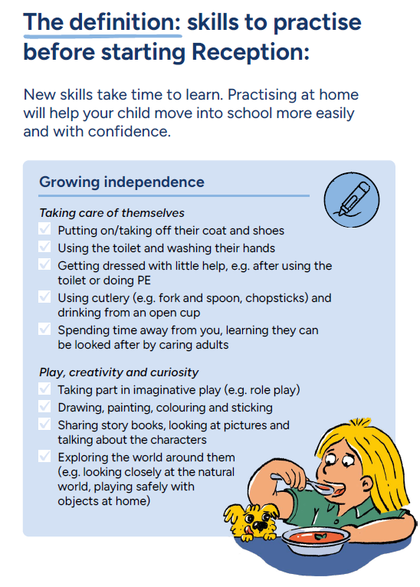

Slide 23
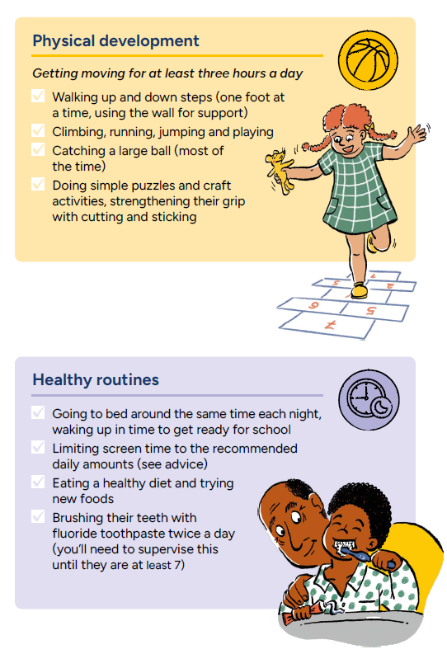
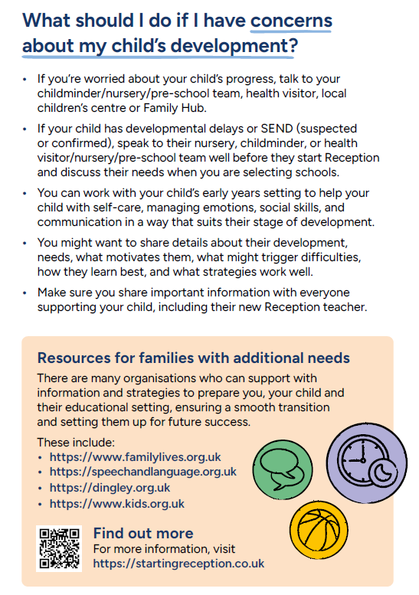

Slide 24

Starting school is an exciting milestone, and we are committed to working in partnership with you to ensure your child has a happy, successful start to their school journey.
We believe that the best outcomes are achieved when school and home work together. If you have any questions, concerns, or information you would like to share, please do not hesitate to speak to us—we are always happy to help.
We look forward to working with you and your child throughout the year.

